Slide 1
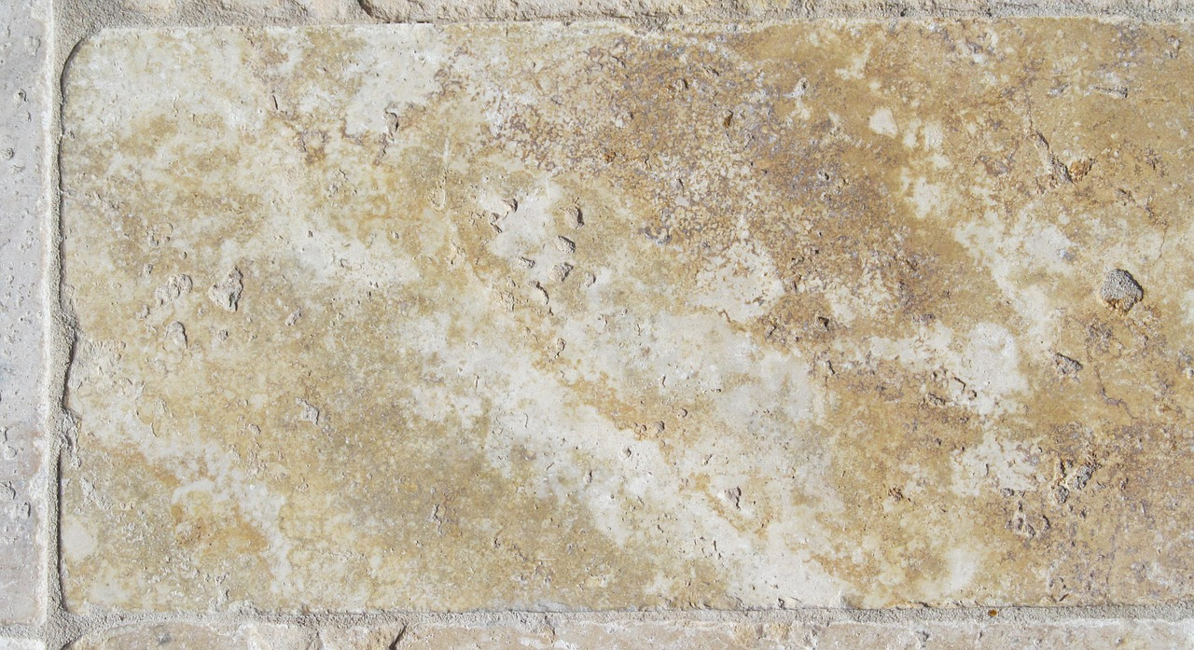

The Gospel of
John

Slide 2

The Gospel of
John
Early Disciples/Wedding at Cana (John 1:35—2:11)

Slide 3
Early Disciples (John 1:35-51)
  Andrew, John, and Peter find the Messiah
  John’s testimony moves Andrew and another disciple (probably John) to follow Jesus (1:35-39).
  Jesus invites them to be witnesses!
    He said to them, "Come and see." They came and saw where He was staying, and remained with Him that day (now it was about the tenth hour). -- John 1:39
  Andrew introduces Simon Peter to Jesus (1:40-42).
    Andrew testifies to his brother: “We have found the Messiah, which is translated ‘the Christ.’”
    Jesus identifies “Simon the son of Jonah” and renames him “Cephas” (Aramaic) = Petros (Greek) = a Stone.
Notes:
“Cephas” is a Chaldee/Aramaic word meaning “a stone,” John translates it into Greek “Petros” which meaning a stone.

Slide 4
Early Disciples (John 1:35-51)
  Philip and Nathanael find the Messiah
  Jesus invited Philip to follow Him (1:43-44)
    Philip was from Bethsaida, a fishing village on the north shore of the Sea of Galilee – the hometown of Peter and Andrew.
  Philip invites Nathanael (1:45-46)
    Philip declares: “We have found Him of whom Moses in the law, and also the prophets, wrote—Jesus of Nazareth, the son of Joseph.”
    Nathanael doubts: “Can any good thing come out of Nazareth.”
    Philip invites Nathanael to “come and see.”
Notes:
Nathanael is almost certainly called the disciple called by his surname “Bartholomew” in the gospels.
the Synoptics and Acts mention Bartholomew but say nothing of Nathanael; John speaks of Nathanael, says nothing of Bartholomew.
The name of Bartholomew is not a proper name; it signifies the son of Ptolomy (Barnes)
John seems to rank Nathanael with the apostles, when he says that Peter and Thomas, the two sons of Zebedee, Nathanael, and two other disciples, being gone a fishing, Jesus showed himself to them, Joh_21:2-4.

Slide 5

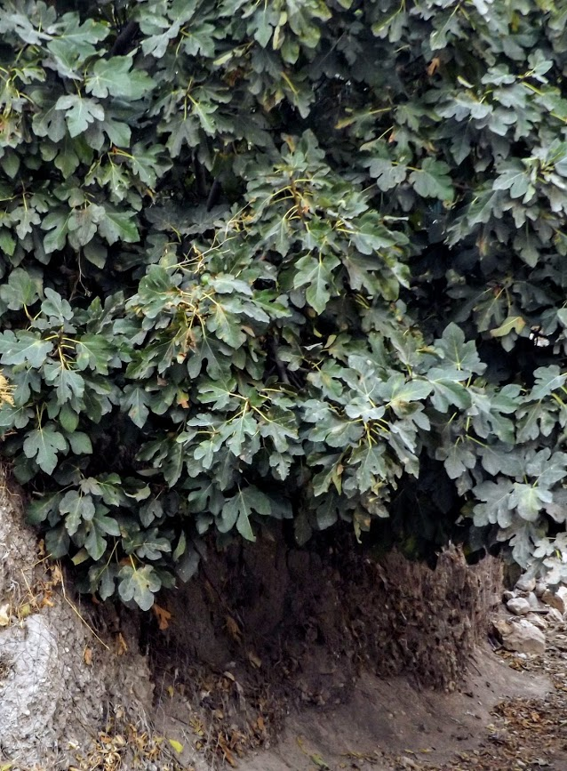
Early Disciples (John 1:35-51)
  Nathanael goes from cynicism to conviction! (1:47-49)
    He’d doubted that anything good could come out of Nazareth.
    Jesus declares Nathanael to be “an Israelite indeed, in whom is no deceit!”
    Jesus knew Nathanael’s character because He had “seen him under the fig tree” before Philip called him” (cf. 1 Kings 4:25; Micah 4:4; Zech. 3:10).
    Nathanael declares “You are the Son of God…the King of Israel!”
Notes:
“Under the fig tree” is symbolic of blessedness and peace in communion with God.
1Ki_4:25 And Judah and Israel dwelt safely, each man under his vine and his fig tree, from Dan as far as Beersheba, all the days of Solomon.
Mic_4:4 But everyone shall sit under his vine and under his fig tree, And no one shall make them afraid; For the mouth of the LORD of hosts has spoken.
Zec_3:10 In that day,' says the LORD of hosts, 'Everyone will invite his neighbor Under his vine and under his fig tree.' "

Slide 6
Early Disciples (John 1:35-51)
  Jesus assures Nathanael that He will see much greater evidence! (1:50-51)
    “Most assuredly, I say to you, hereafter you shall see heaven open, and the angels of God ascending and descending upon the Son of Man.”
    In Genesis 28:10-17, God showed Jacob (Israel) a ladder to heaven and promised to bless “all the families of the earth” in his seed.
    Jesus is the “ladder” upon which those blessings would come.
Notes:
Genesis 28:10-17 Now Jacob went out from Beersheba and went toward Haran. 11 So he came to a certain place and stayed there all night, because the sun had set. And he took one of the stones of that place and put it at his head, and he lay down in that place to sleep. 12 Then he dreamed, and behold, a ladder was set up on the earth, and its top reached to heaven; and there the angels of God were ascending and descending on it. 13 And behold, the LORD stood above it and said: "I am the LORD God of Abraham your father and the God of Isaac; the land on which you lie I will give to you and your descendants. 14 Also your descendants shall be as the dust of the earth; you shall spread abroad to the west and the east, to the north and the south; and in you and in your seed all the families of the earth shall be blessed. 15 Behold, I am with you and will keep you wherever you go, and will bring you back to this land; for I will not leave you until I have done what I have spoken to you." 16 Then Jacob awoke from his sleep and said, "Surely the LORD is in this place, and I did not know it." 17 And he was afraid and said, "How awesome is this place! This is none other than the house of God, and this is the gate of heaven!"

Slide 7
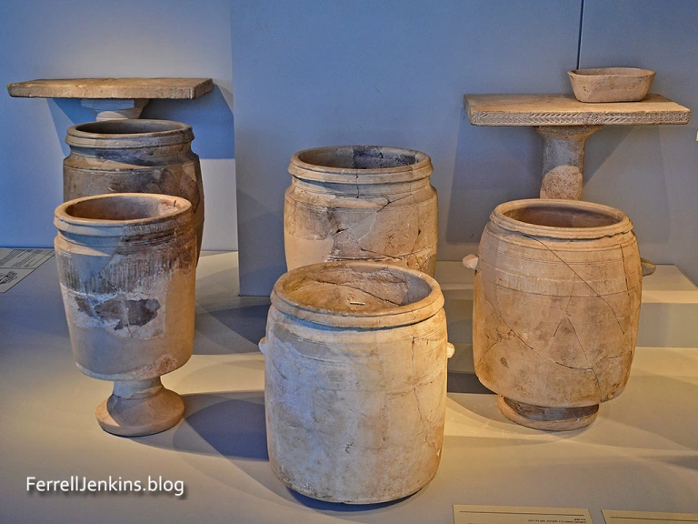
The Wedding at Cana (John 2:1-12)
  Jesus and his disciples are invited to a wedding in Cana of Galilee; Jesus’ mother is there (2:1-2)
  They run out of wine.
  When Jesus’ mother tells Him of the problem, He gently reminds her that her earthly concerns do not determine the timetable of His ministry (2:3-4).
  Jesus supplies the needed wine (2:3-7)
  Mary shows complete confidence in His abilities (2:5)
  He instructs the servants to fill six water pots to the brim with water, each pot had a capacity of 20 to 30 gallons.
Notes:
What facts would Mary have known about Jesus that few others would have known at this time?
Gabriel’s announcement Luke 1:26-35
The visit of the shepherds Luke 2:8-19,
Jesus in the temple at 12 years of age Luke 2:46-51
The true genealogy of Jesus 3:23)

Slide 8
The Wedding at Cana (John 2:1-12)
  The sign of the wine (2:8-11)
  Jesus instructs the servants to "Draw some out now, and take it to the master of the feast" (2:8).
  The master of the feast declares the wine to be superior to that which was served at first (2:9-10)
    NOTE: The master indicates that those present had “well drunk” (were satiated) already.
  “This beginning of signs Jesus did in Cana of Galilee, and manifested His glory; and His disciples believed in Him” (2:11).

Slide 9
The Wedding at Cana (John 2:1-12)
  Does this event justify drinking alcohol on social occasions?
  Does the Bible sometimes use the word "wine" to refer to grape juice without any alcoholic content? (Isaiah 65:8).
  Did the law of God which Jesus lived under condemn drunkenness? (Proverbs 20:1; 23:29-35).
  Did the law which Jesus made through His apostles condemn drinking and drunkenness? (1 Corinthians 6:9-11; 1 Peter 4:3).
  Had the guests at this wedding feast in Cana already had a lot to drink? (1:10).
  Do you believe that Jesus would have given 150 more gallons of wine with alcohol in it to people who were already filled with alcoholic wine?
Notes:
Isa 65:8 Thus says the LORD: "As the new wine is found in the cluster. The “winepress” testifies to this truth.
Proverbs 20:1 Wine is a mocker, Strong drink is a brawler, And whoever is led astray by it is not wise.
Proverbs 23:29-35 Who has woe? Who has sorrow? Who has contentions? Who has complaints? Who has wounds without cause? Who has redness of eyes? 30 Those who linger long at the wine, Those who go in search of mixed wine. 31 Do not look on the wine when it is red, When it sparkles in the cup, When it swirls around smoothly; 32 At the last it bites like a serpent, And stings like a viper. 33 Your eyes will see strange things, And your heart will utter perverse things. 34 Yes, you will be like one who lies down in the midst of the sea, Or like one who lies at the top of the mast, saying: 35 "They have struck me, but I was not hurt; They have beaten me, but I did not feel it. When shall I awake, that I may seek another drink?“
1 Corinthians 6:9-10 Do you not know that the unrighteous will not inherit the kingdom of God? Do not be deceived. Neither fornicators, nor idolaters, nor adulterers, nor homosexuals, nor sodomites, 10 nor thieves, nor covetous, nor drunkards, nor revilers, nor extortioners will inherit the kingdom of God.
1 Peter 4:3 For we have spent enough of our past lifetime in doing the will of the Gentiles—when we walked in lewdness, lusts, drunkenness, revelries, drinking parties, and abominable idolatries.

Slide 10
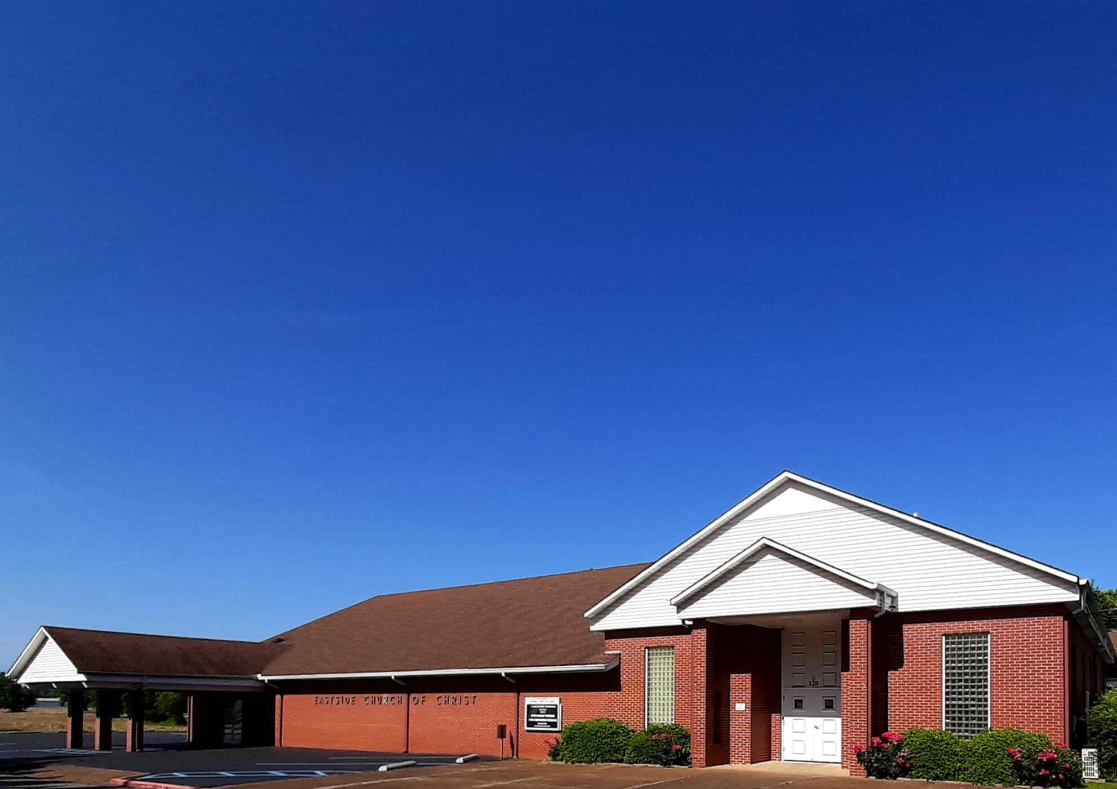
Eastside Church of Christ
Eastside-church.org

